Slide 1

DEE 4544 DIGITAL ELECTRONICS Chapter 3: Logic Function Realization with MSI Circuits
By : Dr. Noraisyah Tajudin
Email: noraisyahtajudin@lincoln.edu.my
Faculty of Engineering
Lincoln University College (LUC)
LECTURE 3
DATE : APRIL 2024

Slide 2
Digital systems obtain data and information continuously operated on in some manner:
Decoding/encoding.
Multiplexing/demultiplexing,.
Comparison; Code conversion; Data busing.
These and other operations have been facilitated by the availability of numerous ICs in the MSI (medium-scale-integration) category.

Slide 3
Decoders
Decoders are used when an output or a group of outputs is to be activated only on the occurrence of a specific combination of input levels.
Often provided by outputs of a counter or a register.

Slide 4
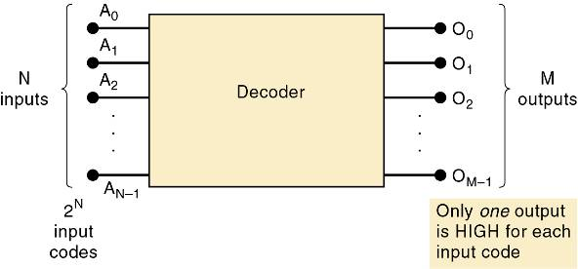
Decoders
A decoder accepts a set of inputs that represents a binary number—activating only the output that corresponds to the input number.
For each of these input combinations, only one of the M outputs will be active (HIGH); all the other outputs are LOW.
Many decoders are designed to produce active-LOW outputs, where only the selected output is LOW while all others are HIGH.

Slide 5
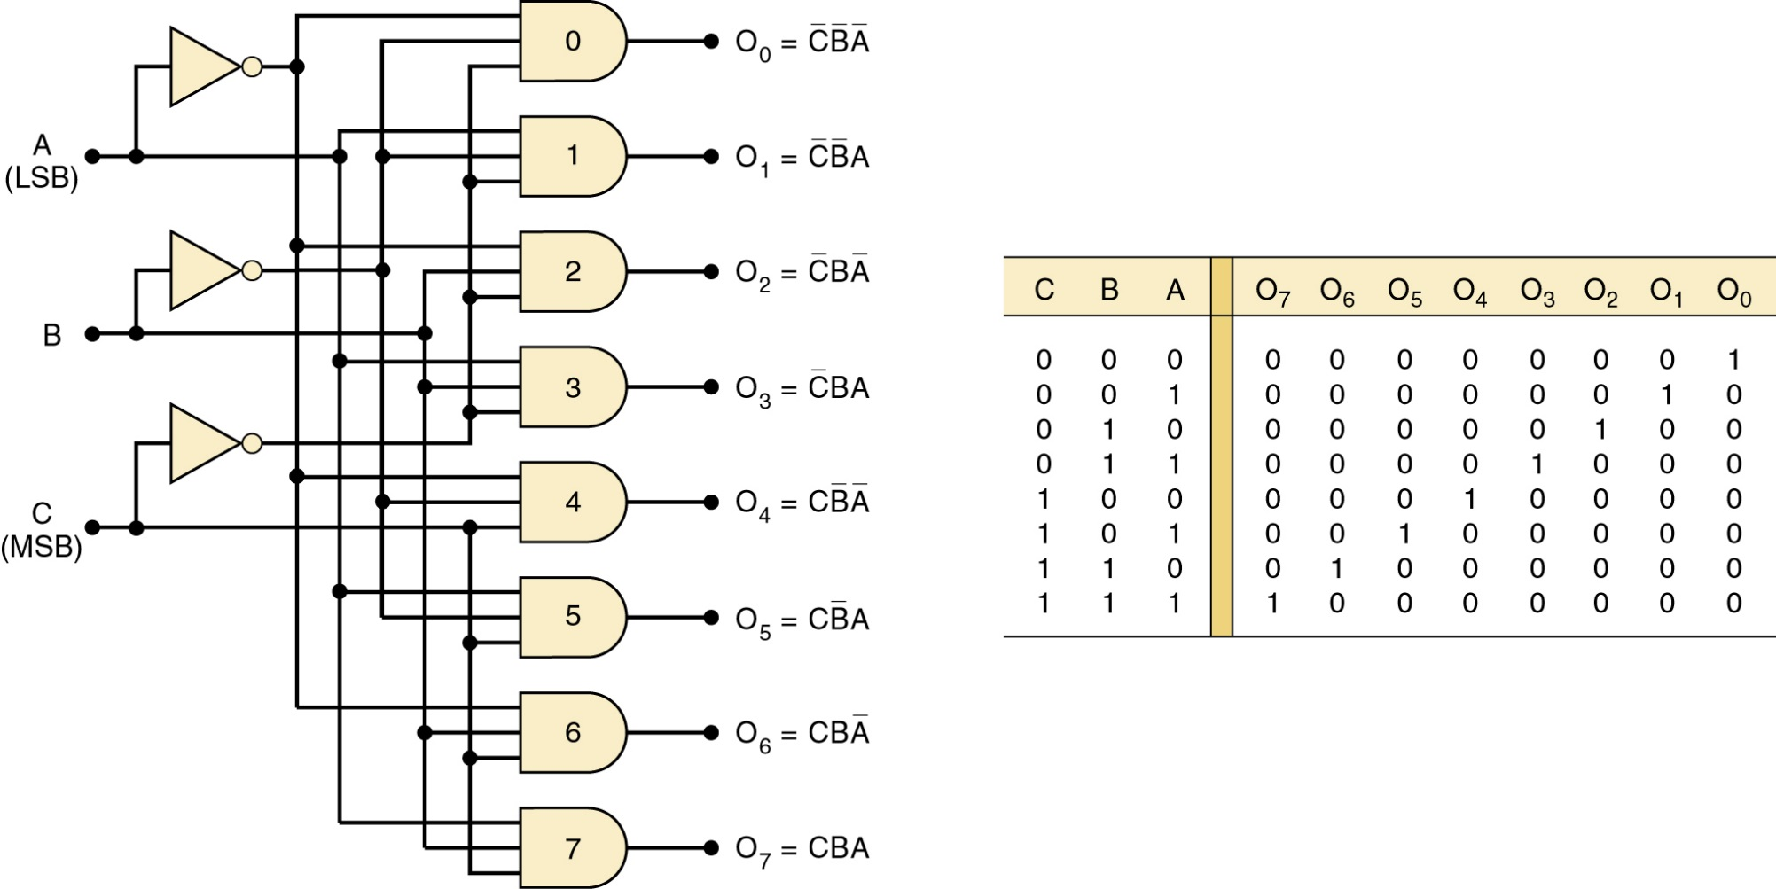
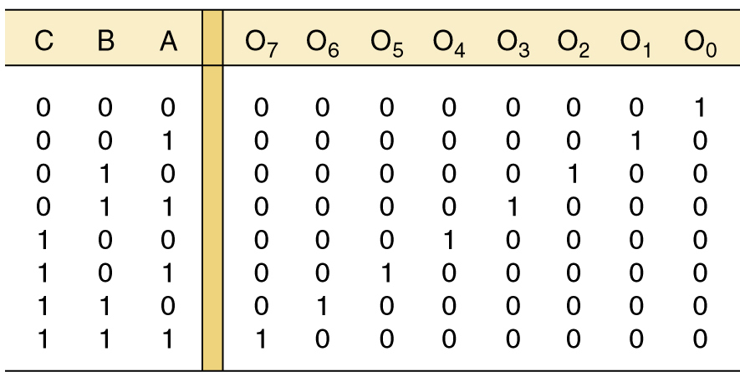
Decoders
Circuitry for a decoder with three inputs and 8 outputs.
It uses all AND gates, so outputs are active-HIGH
Output O6 goes HIGH only when CBA 1102 = 610.

Slide 6
Decoders
Circuitry for a decoder with three inputs and 8 outputs.
This can be called a 3-line-to-8-line decoder—it has three input lines and eight output lines.
Also called a binary-to-octal decoder or converter—taking three-bit binary input code and activating one of eight (octal) outputs.
Also referred to as a 1-of-8 decoder—only 1 of the 8 outputs is activated at one time.

Slide 7
Decoders
Some decoders have one or more enable inputs used to control the operation of the decoder.
The decoder is enabled only if ENABLE is HIGH.
With common ENABLE line connected to a fourth input of each gate:
If ENABLE is HIGH, the decoder functions normally.
A, B, C input will determine which output is HIGH.
If ENABLE is LOW, all outputs will be forced LOW.
Regardless of the levels at the A, B, C inputs.

Slide 8
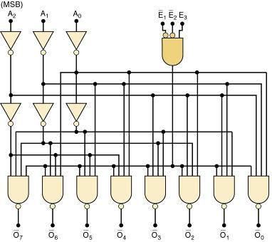
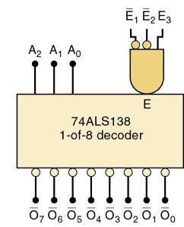
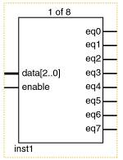
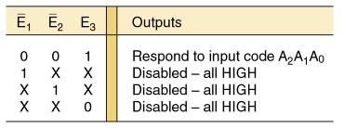
Decoders
The 74ALS138 decoder.
ENABLE inputs

Slide 9
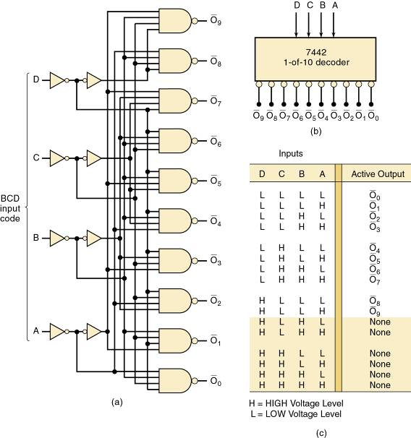
Decoders
7442 BCD-to-decimal decoder.
This decoder does not have an enable input.

Slide 10
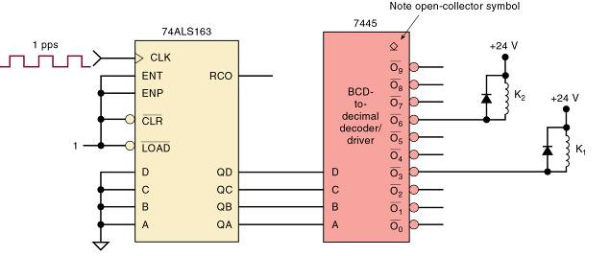
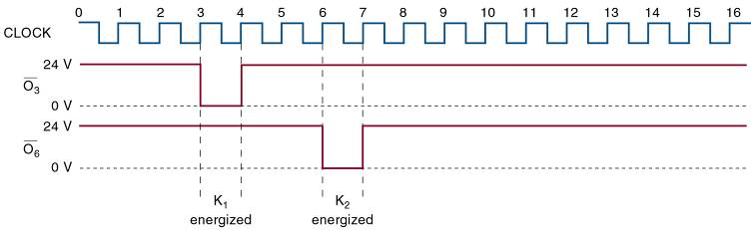
Decoders
7445 BCD-to-decimal decoder/driver.
Suitable for directly driving loads such as indicator LEDs or lamps, relays, or dc motors.
Termed a driver because this IC has open-collector outputs that operate at higher current/voltage limits than a normal TTL output.

Slide 11
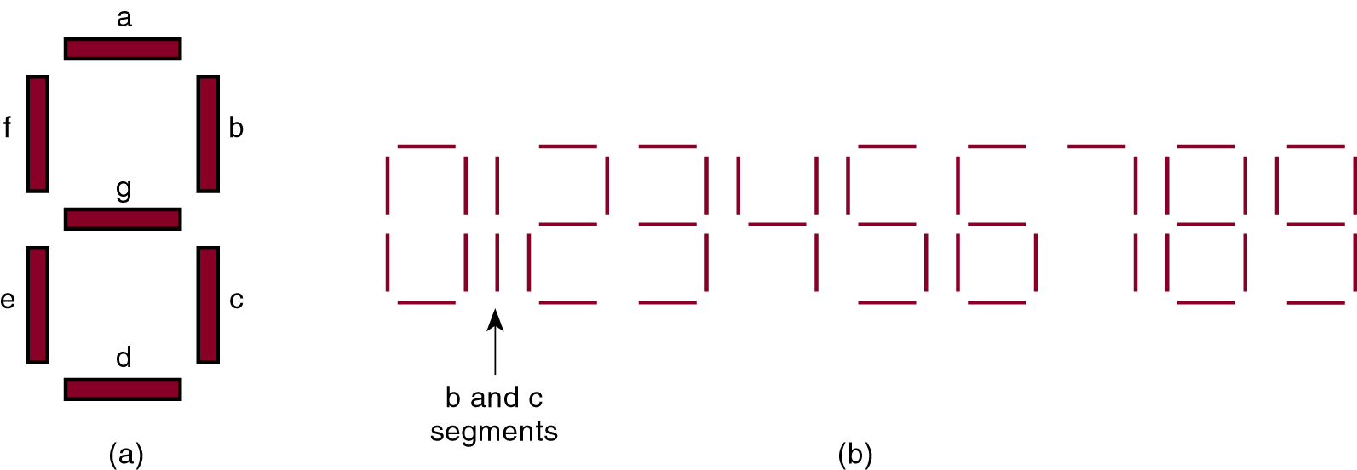
9-2 BCD-to-7 Segment Decoder/Drivers
The 7-segment display is a common way to display decimal or hexadecimal characters.
One common arrangement uses light emitting diodes (LEDs) for each segment.
Diodes allow current to flow in one direction, but block flow in the other direction.
When the LED anode is more positive than the cathode by approximately 2 V, the LED will light up.

Slide 12
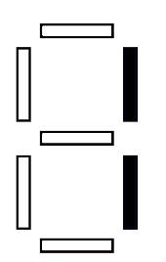
9-2 BCD-to-7 Segment Decoder/Drivers
The 7-segment display is a common way to display decimal or hexadecimal characters.
One common arrangement uses light emitting diodes (LEDs) for each segment.
By controlling current through each LED, some segments are turned on & emit light, while others are turned off, which generates the desired character pattern.

Slide 13
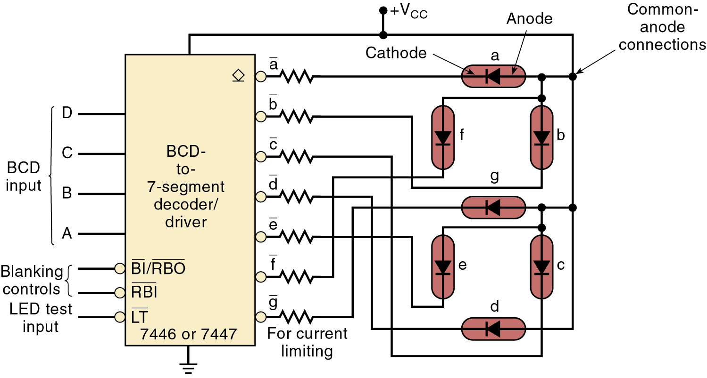
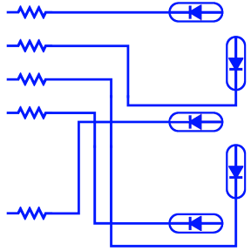
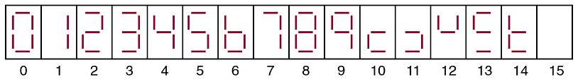

9-2 BCD-to-7 Segment Decoder/Drivers
BCD-to-7-segment decoder/driver.
The 7446/47 activates specific segment patterns in response to input codes

Slide 14
9-2 BCD-to-7 Segment Decoder/Drivers
BCD-to-7-segment decoder/driver.
This is a common-anode LED display.
The anodes all of segments are tied together to VCC .
Another type uses a common-cathode method, with each segment requiring 10 to 20 mA of current.
TTL/CMOS devices are normally not used to drive a common-cathode display directly—a transistor interface circuit is often used

Slide 15
Encoders
9-4 Encoders
Most decoders accept an input code & produce a HIGH (or LOW) at one and only one output line.
A decoder identifies, recognizes, or detects a particular code.

Slide 16
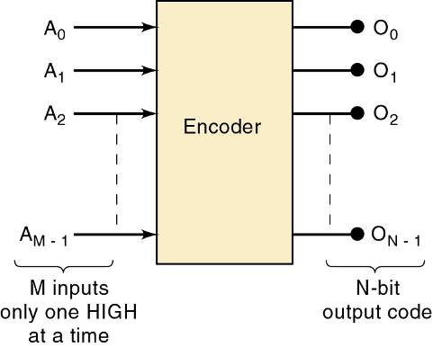
Encoders
The opposite of decoding process is encoding.
Performed by a logic circuit called an encoder.
An encoder has a number of input lines, only one of which is activated at a given time.
Shown is an encoder with M inputs and N outputs. Inputs are active-HIGH, which means that they are normally LOW.
It produces an N-bit output code, depending on which input is activated.

Slide 17
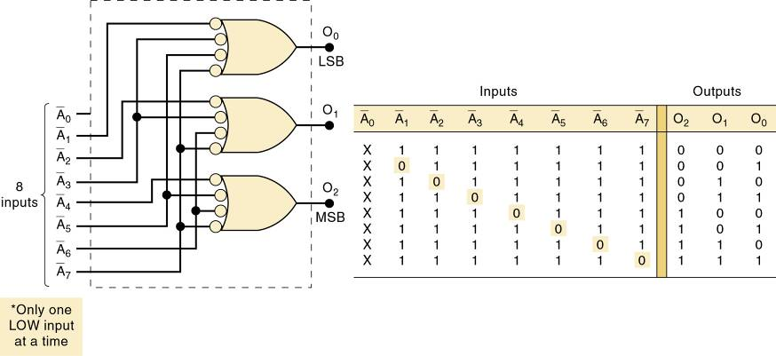
Encoders
An octal-to-binary encoder (8-line-to-3-line encoder) accepts eight input lines, producing a three-bit output code corresponding to the input.
Logic circuit for an octal-to-binary (8-line-to-3-line) encoder. Only one input should be active at one time.

Slide 18
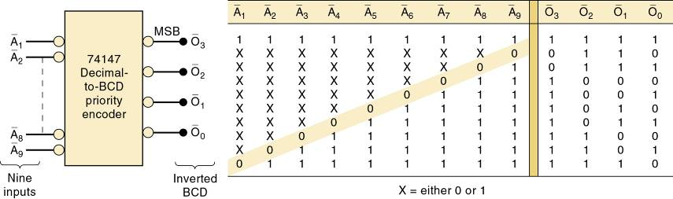
Encoders
A priority encoder ensures that when two or more inputs are activated, the output code will correspond to the highest-numbered input.
It has nine active-LOW inputs represent decimal digits 1 through 9, producing inverted BCD code corresponding to the highest-numbered activated input.

Slide 19
Encoders
A switch encoder can be used when BCD data must be entered manually into a digital system.
The 10 switches might be the keyboard switches on a calculator—representing digits 0 through 9.

Slide 20
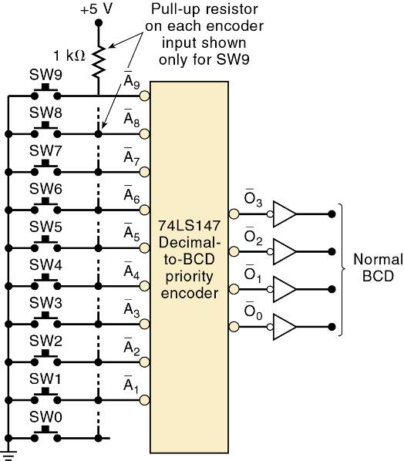
Encoders
The switches are of the normally open type, so the encoder inputs are all normally HIGH.
BCD output is 0000.
When a key is depressed, the circuit will produce the BCD code for that digit.
The 74LS147 is a priority encoder, so simultaneous key depressions produce the BCD code for the higher-numbered key.

Slide 21
Troubleshooting
More complex circuitry increases possible reasons for failure
Applying observation and analysis will narrow the focus and simplify testing
After using observation and analysis to determine the possible faults, repeatedly use the divide and conquer technique to reduce possible causes by half.

Slide 22
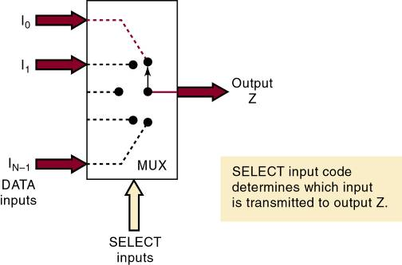
Multiplexers (Data Selectors)
A multiplexer (MUX) selects 1 of N input data sources and transmits the selected data to a single output—called multiplexing.
A digital multiplexer or data selector is a logic circuit that performs the same task.
Routing control of desired data input to output by SELECT inputs—referred to as ADDRESS inputs.

Slide 23
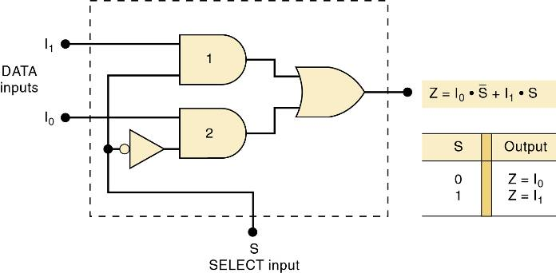
Multiplexers (Data Selectors)
A two-input MUX could be used in a digital system that uses two different MASTER CLOCK signals.
A high-speed clock in one mode and a slow-speed clock for the other.

Slide 24
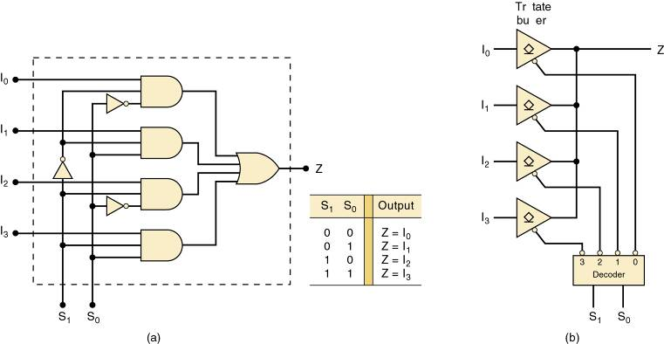
Multiplexers (Data Selectors)
Two-, four-, eight-, and 16-input multiplexers are available in the TTL and CMOS logic families.
These basic ICs can be combined for multiplexing a larger number of inputs.

Slide 25
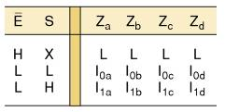
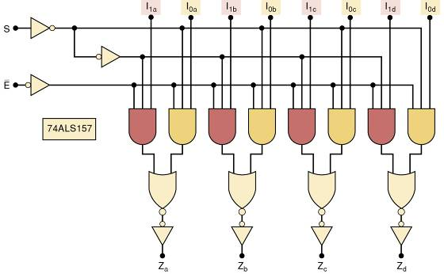
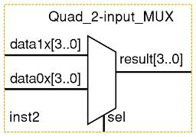
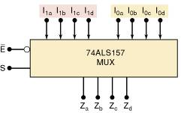
Multiplexers (Data Selectors)
The 74ALS157 contains four two-input multiplexers

Slide 26
Multiplexer Applications
Multiplexer circuits find numerous and varied applications in digital systems of all types.
Data selection/routing, parallel-to-serial conversion.
Operation sequencing.
Waveform/logic-function generation.

Slide 27
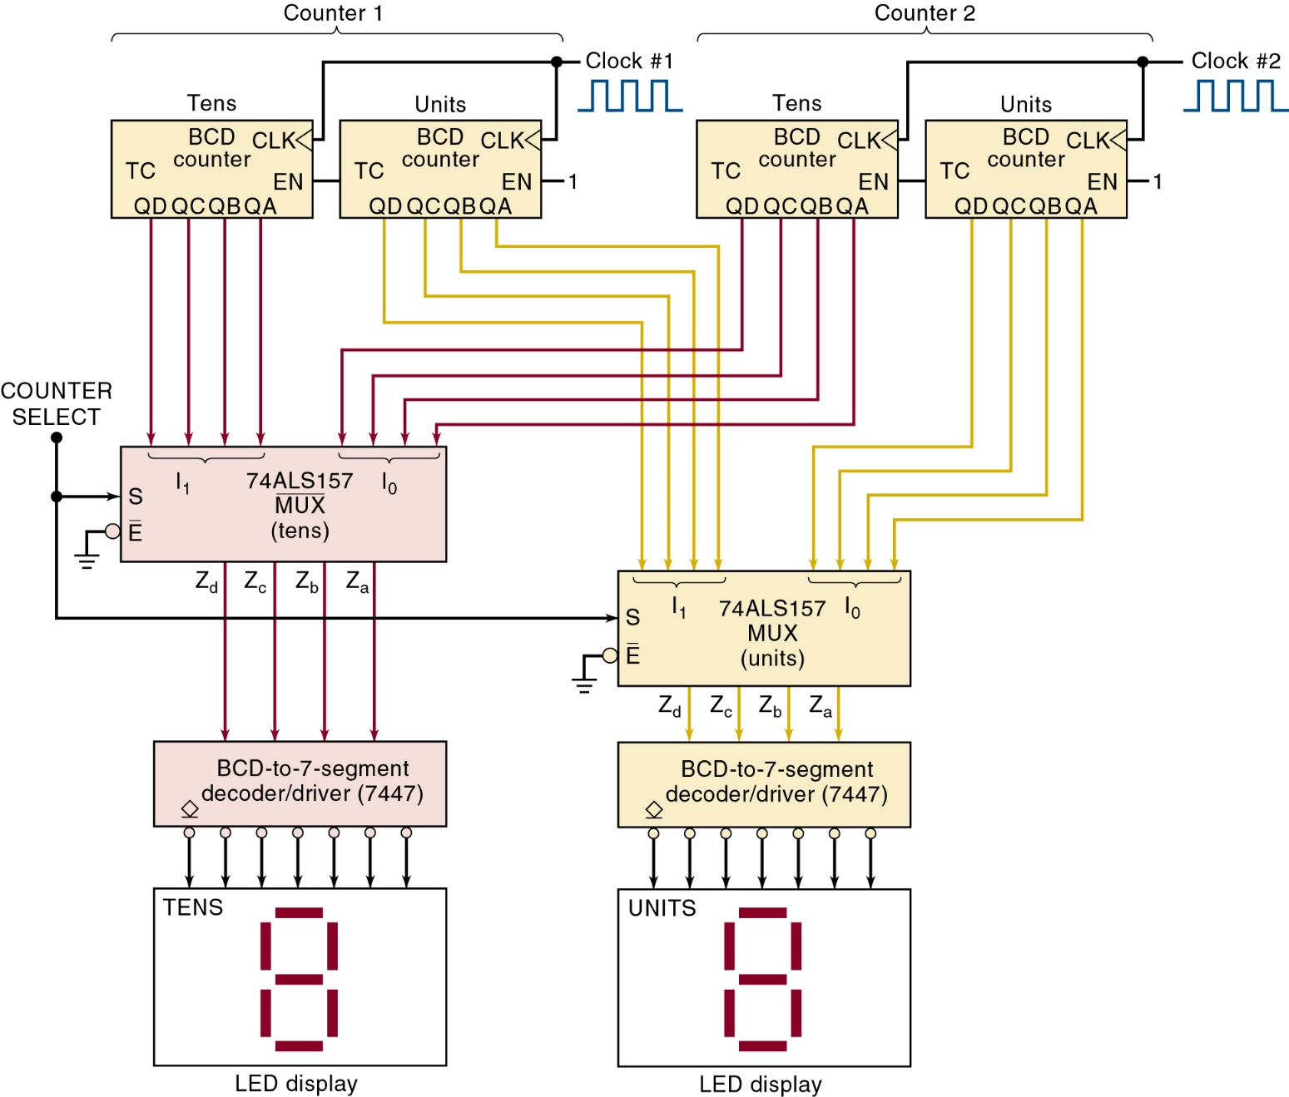
Multiplexer Applications
System for displaying two multidigit BCD counters one at a time.

Slide 28
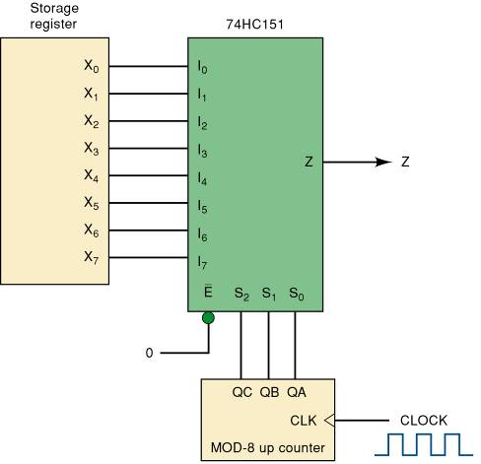
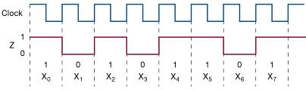
Multiplexer Applications
Parallel-to-serial converter.
Waveforms for X7X6X5X4X3X2X1X0 10110101

Slide 29
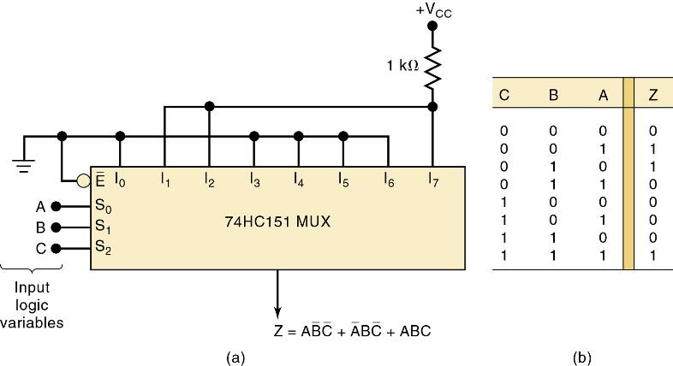
Multiplexer Applications
Multiplexer used to implement a logic function described by the truth table.

Slide 30
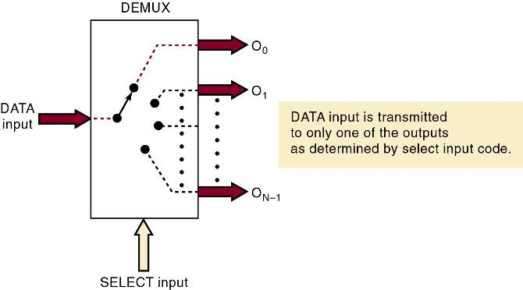
Demultiplexers (Data Distributors)
A demultiplexer (DEMUX) takes a single input and distributes it over several outputs.
The select input code determines to which output the DATA input will be transmitted.

Slide 31
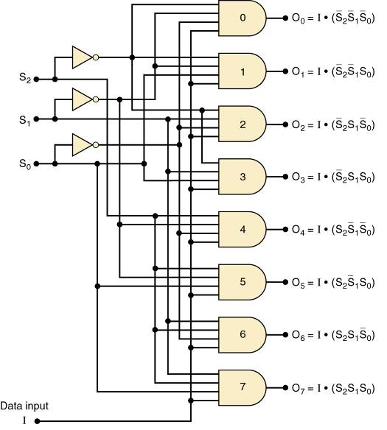
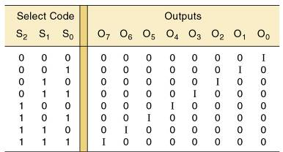

Demultiplexers (Data Distributors)
A 1 line to 8 line demultiplexer.

Slide 32
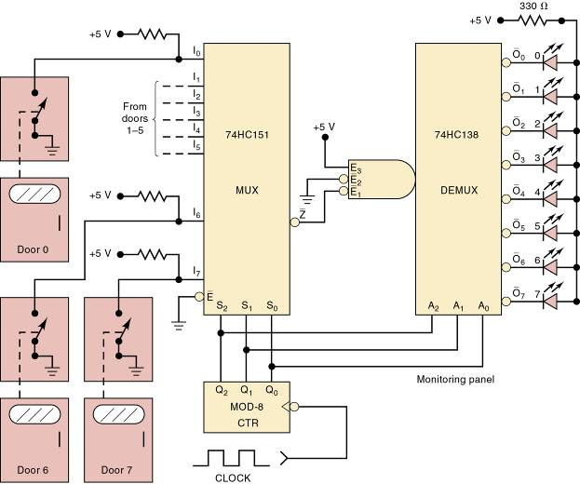
Demultiplexers (Data Distributors)
Security monitoring system using the 74ALS138.
The system shown can handle eight doors, but can be expanded to any number.
The door switches are data inputs to the MUX. They produce a HIGH when a door is open and a LOW when it is closed.

Slide 33
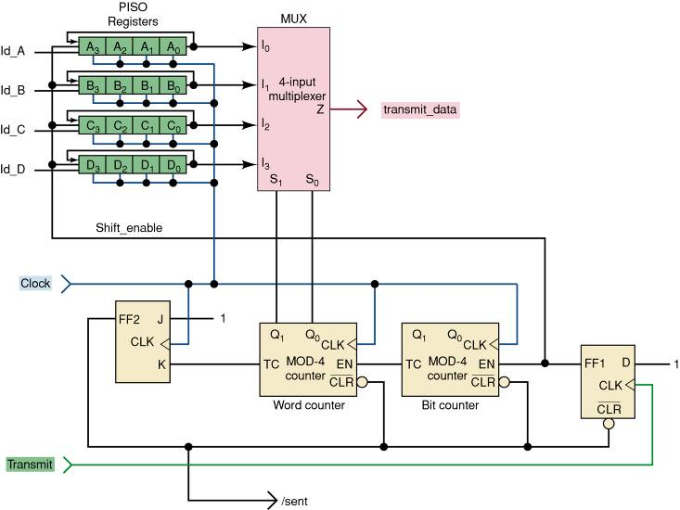
Demultiplexers (Data Distributors)
A synchronous data transmission system that is used to transmit four, four-bit words serially from a transmitter to a remote receiver.

Slide 34
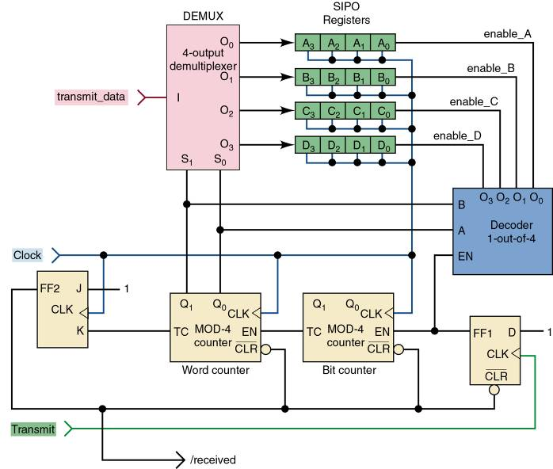
Demultiplexers (Data Distributors)
Synchronous data transmission system receiver block

Slide 35
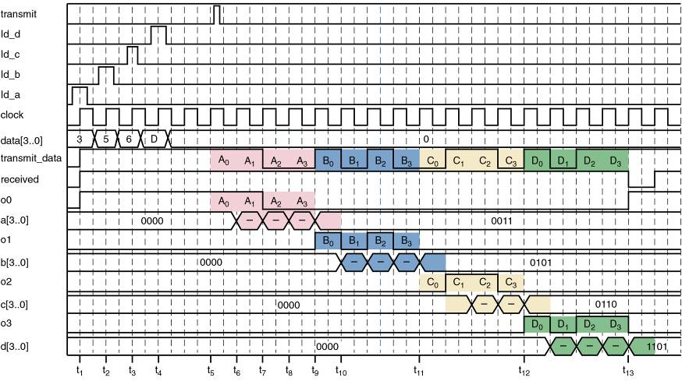
Demultiplexers (Data Distributors)
This timing diagram shows the parallel data loaded into the transmitter, the serial data stream, and distribution/storage of the four data values in the receiver registers.

Slide 36
Digital integrated circuit design can present a variety of challenges and issues. Some common issues include:
Timing: Ensuring that signals propagate through the circuit at the correct times can be challenging, especially in complex designs.
Power consumption: Managing power consumption is crucial, especially in portable devices. Designers must balance performance with energy efficiency.
Signal integrity: Maintaining the integrity of signals as they travel through the circuit is essential to prevent errors and data corruption.
Layout and routing: Efficiently laying out and routing the components of the circuit to minimize space and optimize performance can be a complex task.

Slide 37
5. Manufacturability: Designing a circuit that is manufacturable within the constraints of the chosen fabrication process is a critical consideration.
6. Testing and verification: Ensuring the functionality and reliability of the design through testing and verification processes is essential.
7. Compatibility and standards: Ensuring that the design adheres to industry standards and is compatible with other system components is important for interoperability.
Addressing these issues requires careful planning, simulation, and validation throughout the design process.

Slide 38
Thank You

